Slide 1

Pokemon for Machine Learning
By Enbo Tian

Slide 2
Introduction and Literature Review
Found by Nintendo in 1996
Began as Pockect Monster: Red and Green
Famous as Pokemon Go
estimated to be the highest-grossing media frachise of all time

Slide 3
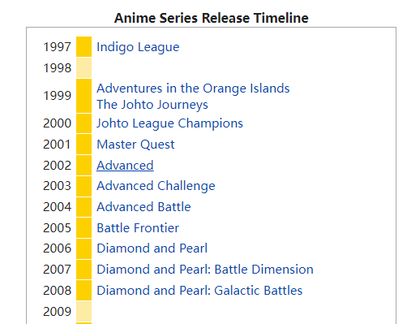
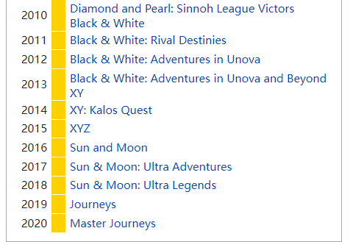
Introduction and Literature Review

Slide 4
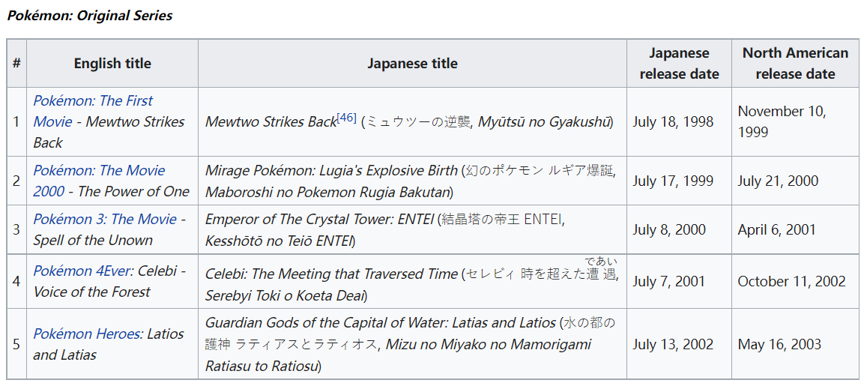
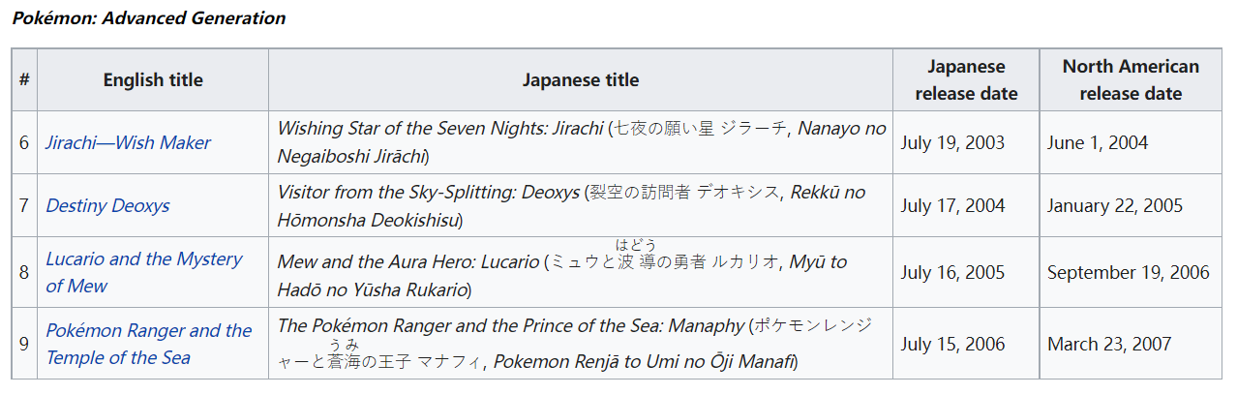
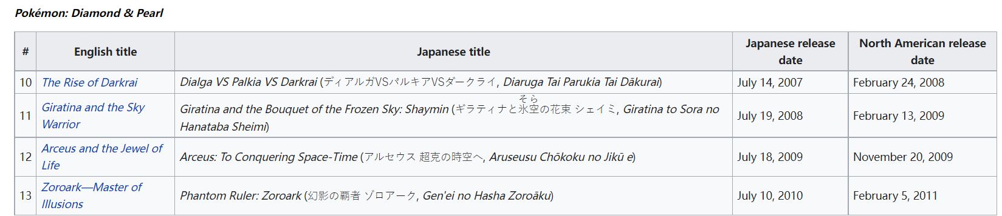
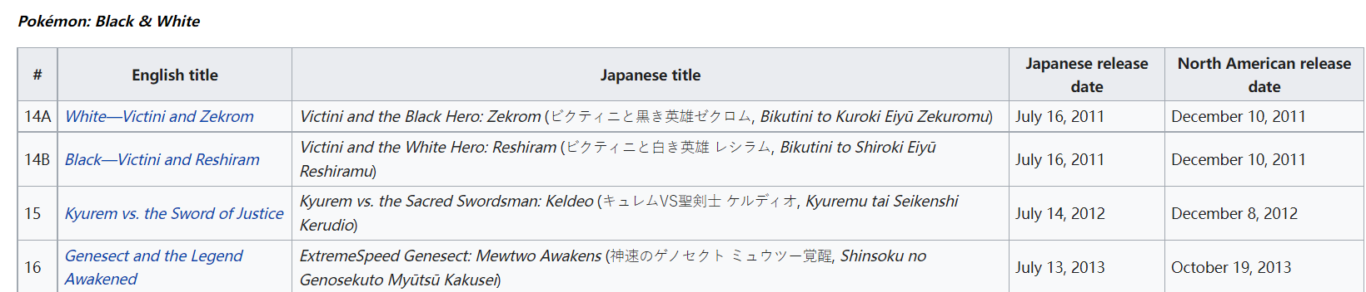
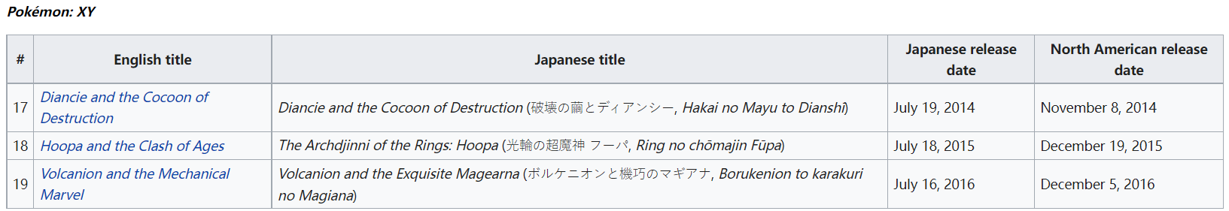
Generation of Pokemon

Slide 5
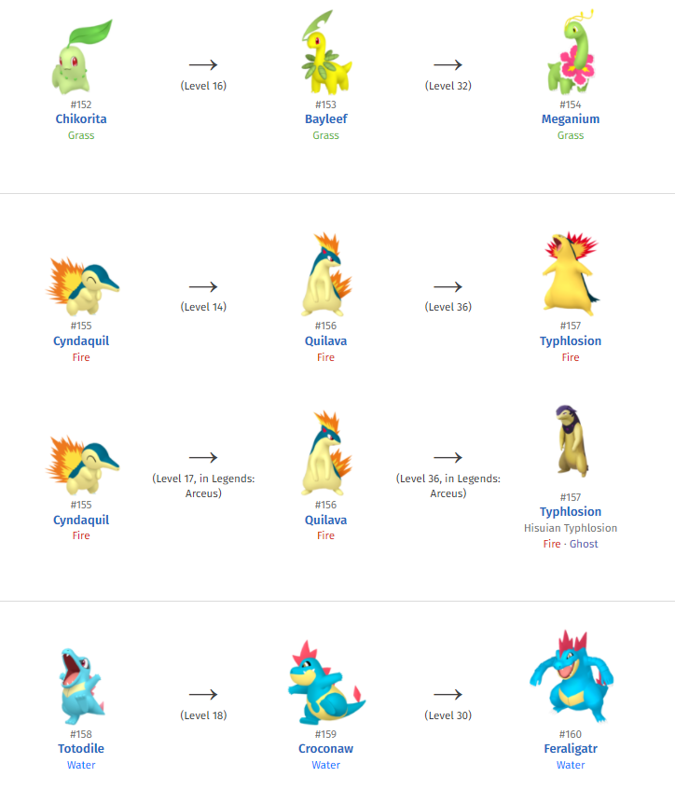
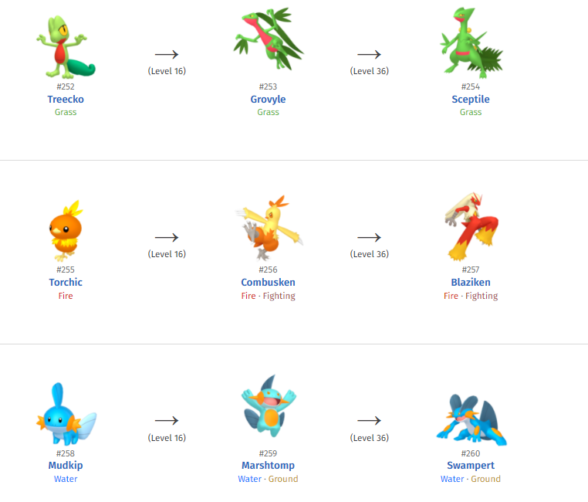
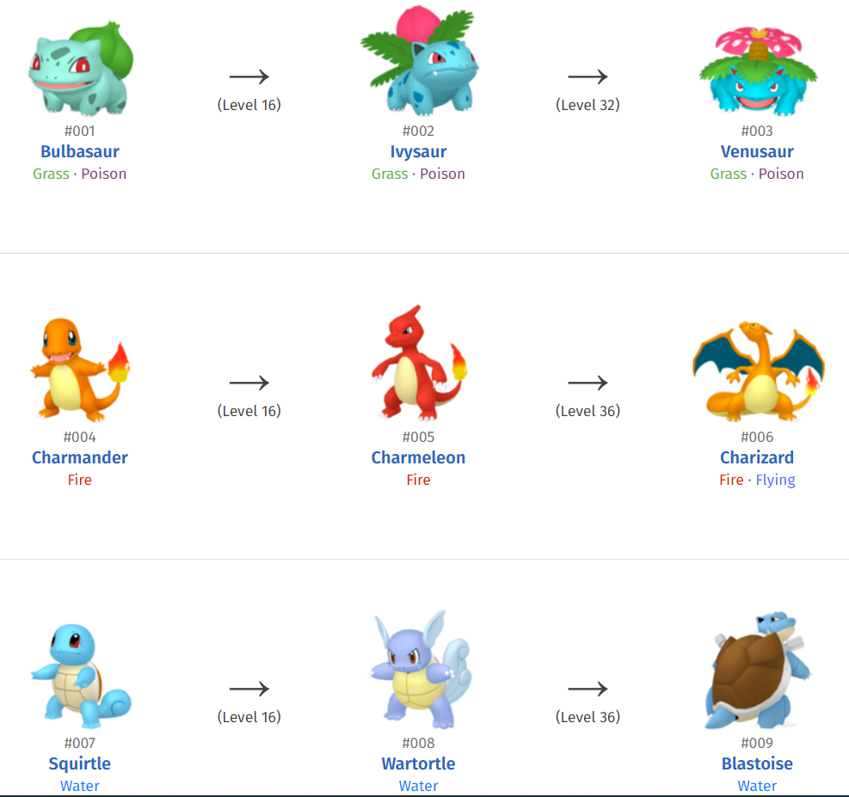
Evolution

Slide 6
Data Source
Number. Pokémon ID in the Pokédex.
Name. Name of the Pokémon.
Type_1. Primary type.
Type_2. Second type, in case the Pokémon has it.
Total. Sum of all the base stats (Health Points, Attack, Defense, Special Attack, Special Defense, and Speed).
HP. Base Health Points.
Attack. Base Attack.
Defense. Base Defense.
Sp_Atk. Base Special Attack.
Sp_Def. Base Special Defense.
Speed. Base Speed.

Slide 7
Data Source
Generation. Number of the generation when the Pokémon was introduced.
isLegendary. Boolean that indicates whether the Pokémon is Legendary or not.
Color. Color of the Pokémon according to the Pokédex.
hasGender. Boolean that indicates if the Pokémon can be classified as female or male.
Pr_male. In case the Pokémon has Gender, the probability of its being male. The probability of being female is, of course, 1 minus this value.
EggGroup1. Egg Group of the Pokémon.
EggGroup2. Second Egg Group of the Pokémon, in case it has two.
hasMegaEvolution. Boolean that indicates whether the Pokémon is able to Mega-evolve or not.
Height_m. Height of the Pokémon, in meters.
Weight_kg. Weight of the Pokémon, in kilograms.
Catch_Rate. Catch Rate.
Body_Style. Body Style of the Pokémon according to the Pokédex.

Slide 8
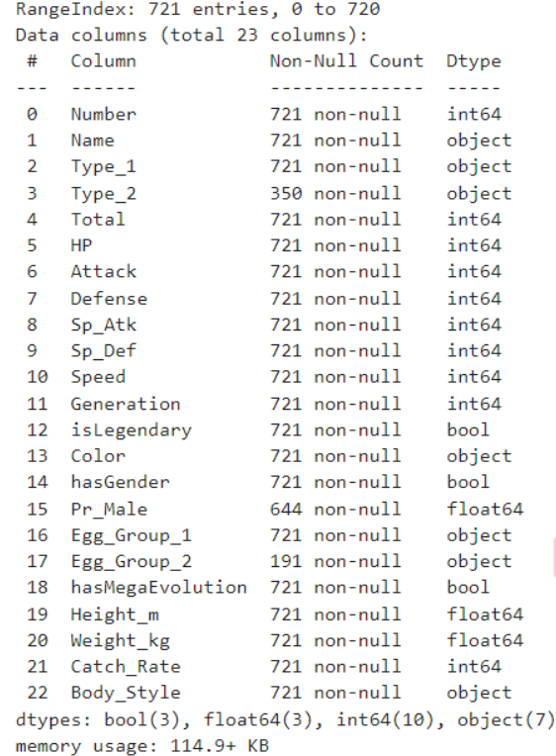
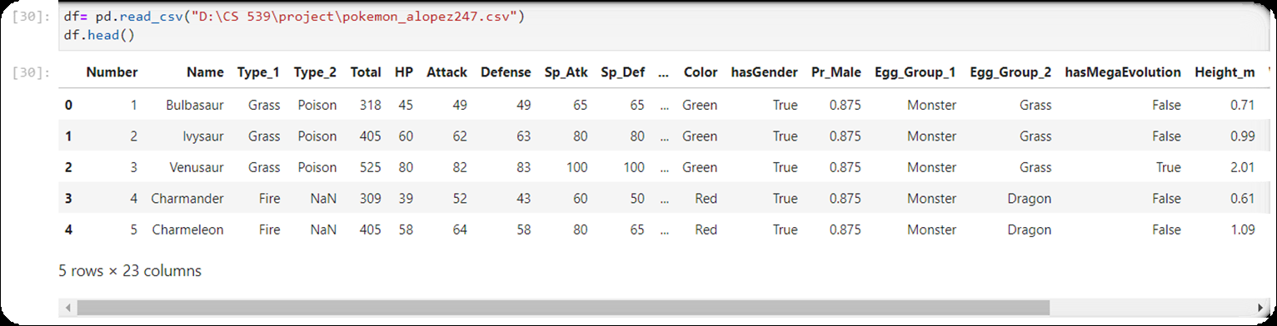
Data Source

Slide 9
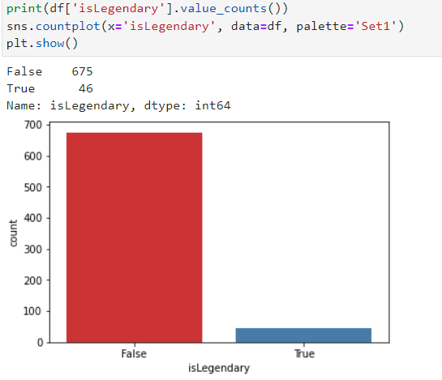
Data Explore

Slide 10
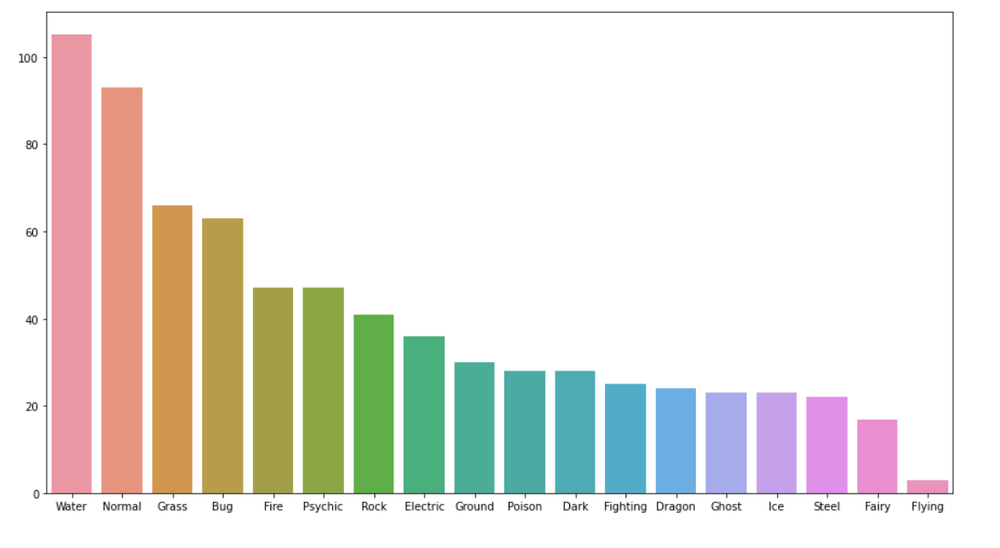
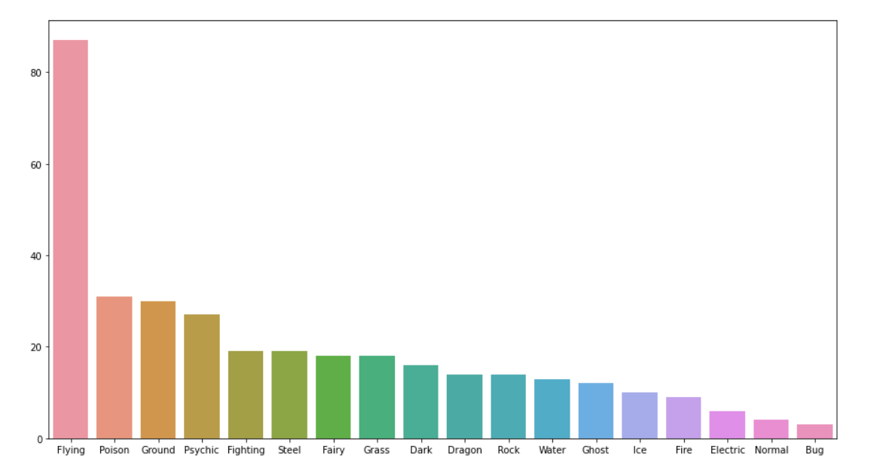
Type I and II

Slide 11
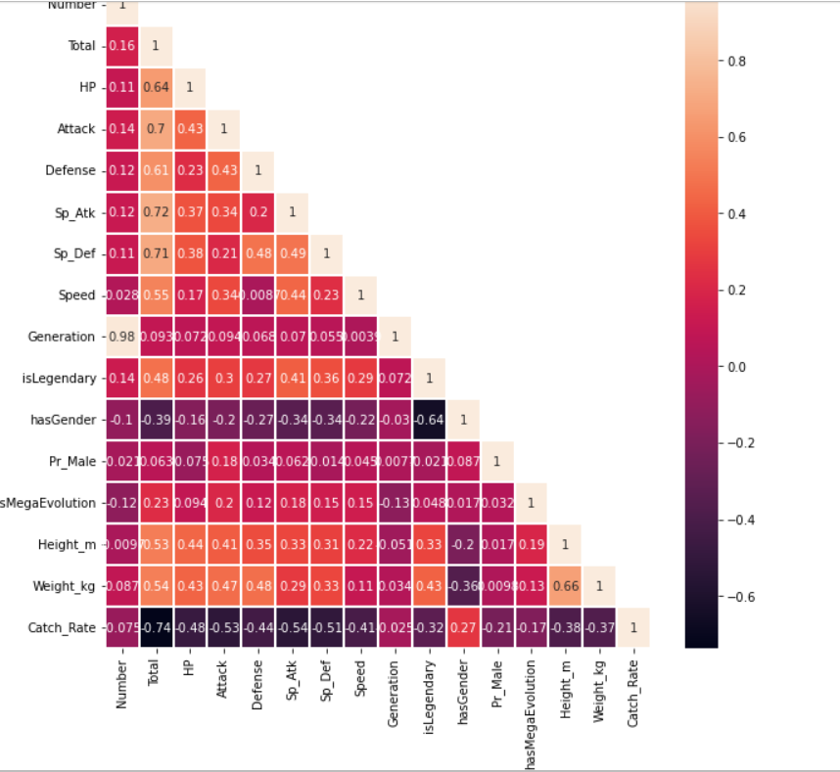
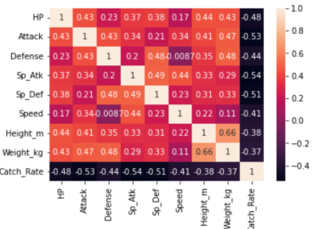
Correlation and Heatmap

Slide 12
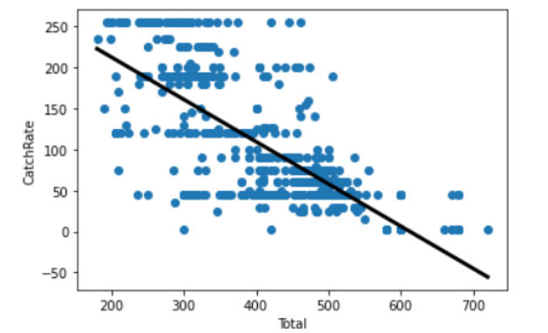
Methodology (Total vs Catch Rate)
Linear Regression
R^2 Score : 0.545

Slide 13
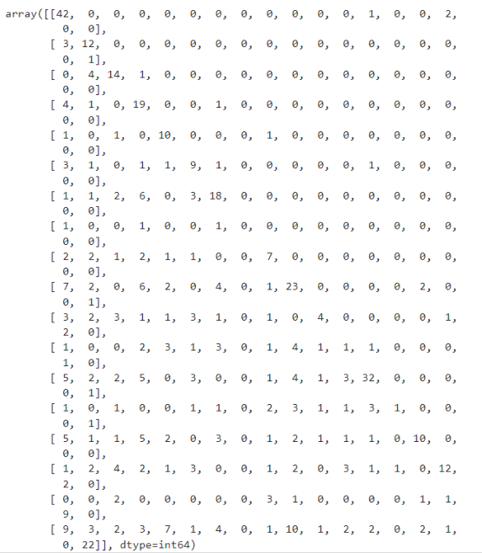
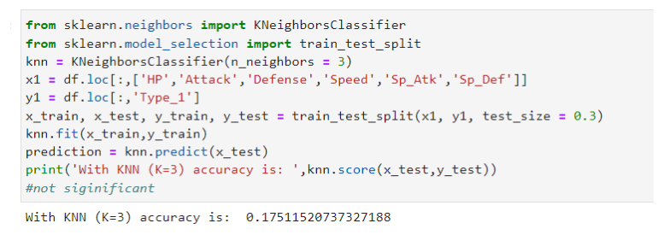
Methodology (Total vs Catch Rate)
KNN (K =3)

Slide 14
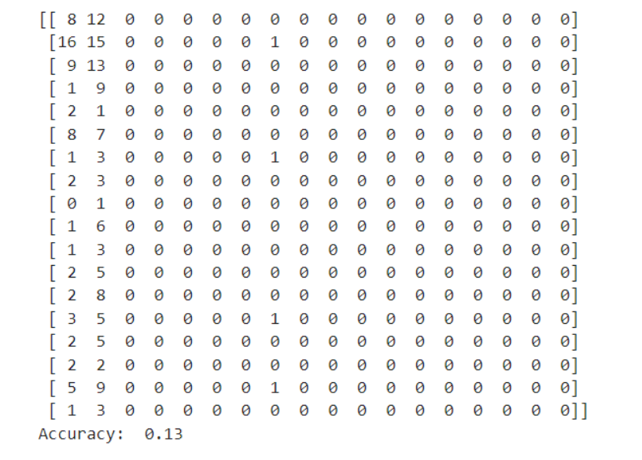
Methodology (Total vs Catch Rate)
Logistic Regression

Slide 15
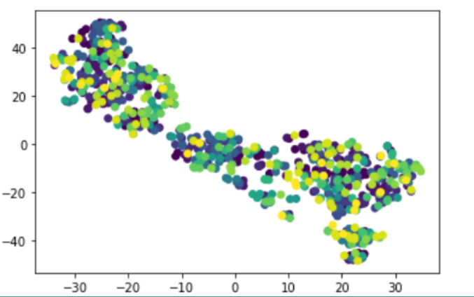
TSNE

Slide 16
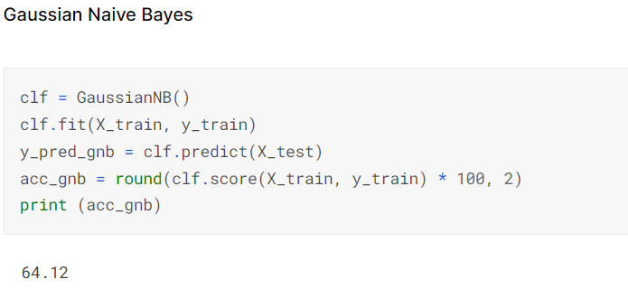
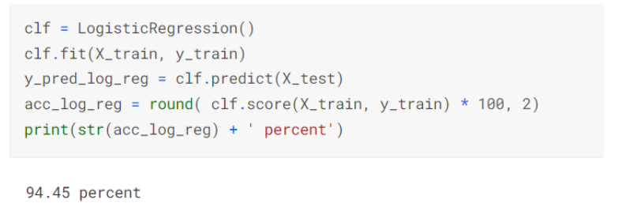
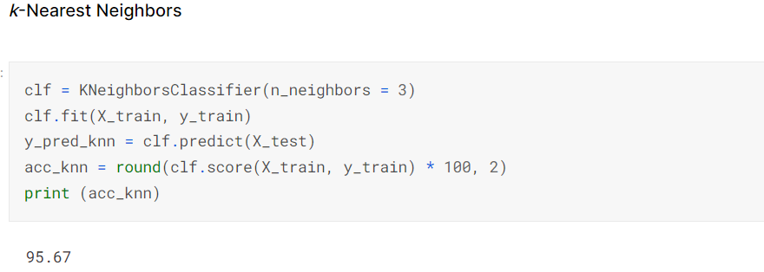
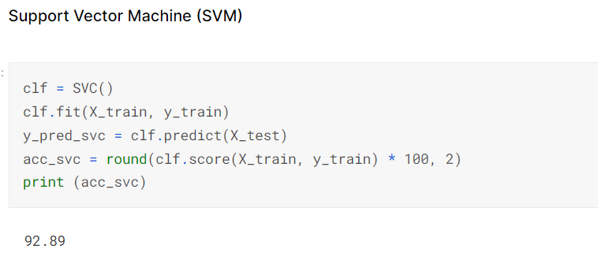
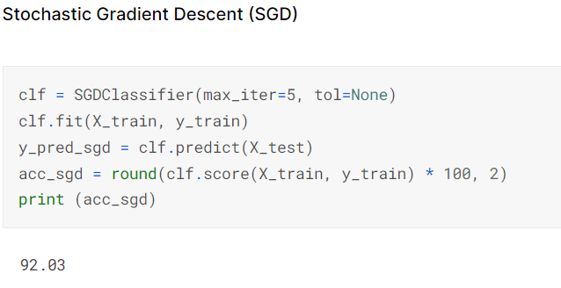
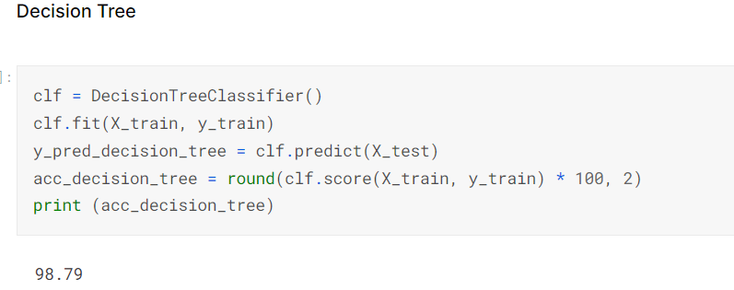
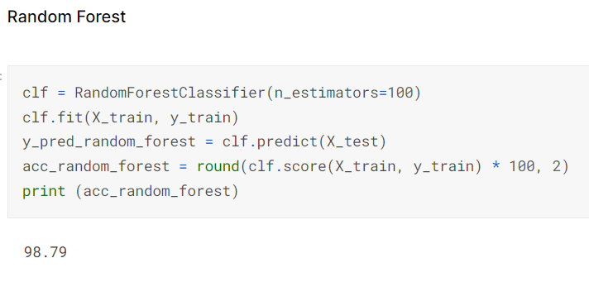
Methodology(isLegendary vs Catch Rate)
Logistic Regression

Slide 17
Conclusion
Logistic Regression: 0.9445
K Nearest Neighbors: 0.9567
Support Vector Machine : 0.9289
Decision Tree: 0.9879
Random Forest: 0.9879 👍
Gaussian Naive Bayes: 0.6412
Stochastic Gradient Descent: 0.9203

